Slide 1
Causes of Slope Failure
CE 544 – BRIGHAM YOUNG UNIVERSITY

Slide 2
Slide Types
Slide types
Long periods of rain produce slow-moving, deep-seated slides
Short periods of intense rain produce shallow, fast-moving slides
Slide growth
Slides that grow uphill by increments are called retrogressive
Slides that grow downhill by increments are call progressive

Slide 3
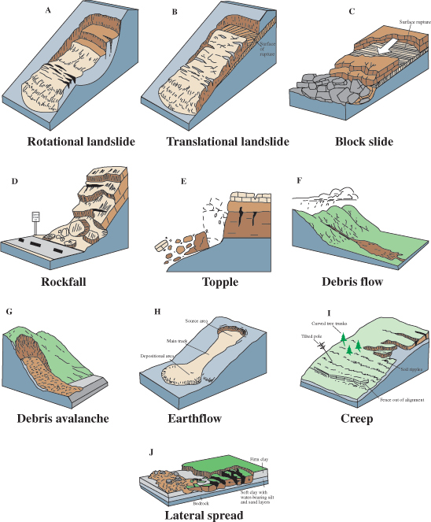
Slide Types
Notes:
Source: http://pubs.usgs.gov/fs/2004/3072/images/Fig3grouping-2LG.jpg

Slide 4
Slide Types, Cont.

Slide 5
Deep-Seated Slides
Examples

Slide 6
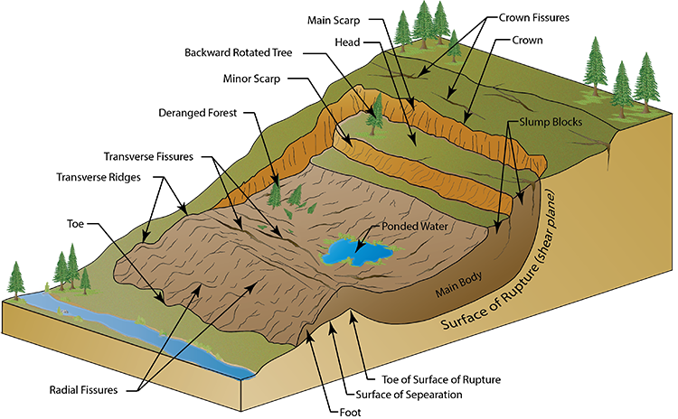
Rotational Landslide Components

Slide 7
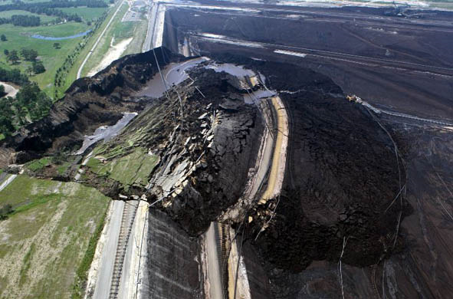
Coal mine in Australia

Slide 8
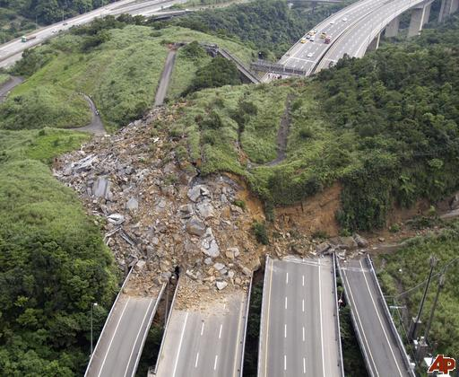
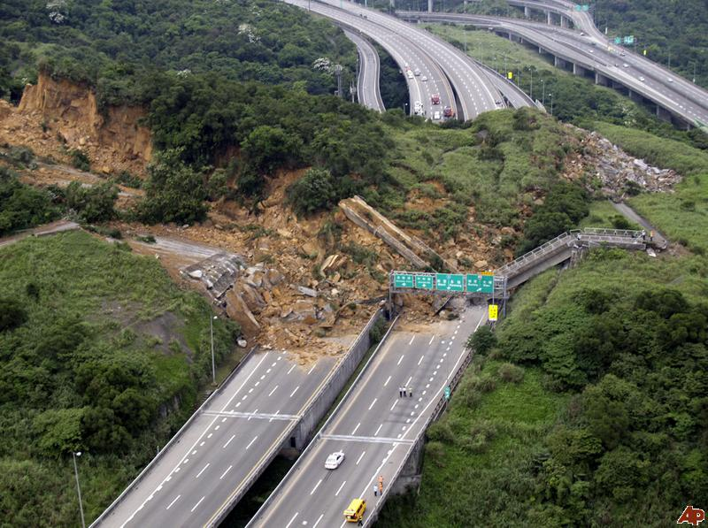
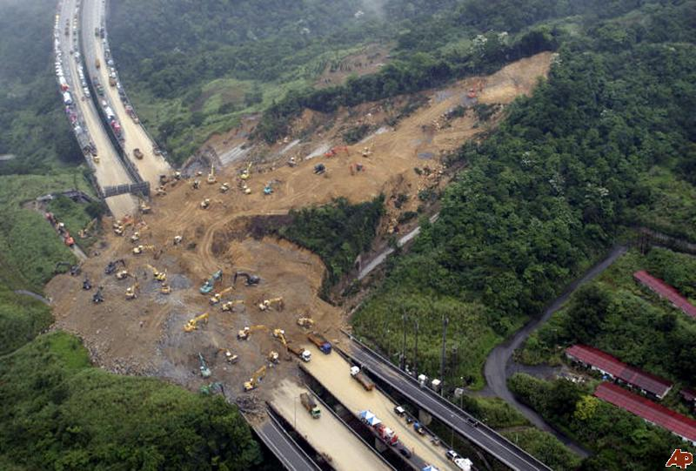
2010 Taiwan Landslide
Notes:
http://www.msnbc.msn.com/id/36782187/
TAIPEI, Taiwan — An official says rescuers are searching for travelers in three cars buried by a massive landslide when a hillside collapsed in northern Taiwan.
Firefighter Tang Cheng-yu says the Sunday landslide buried a portion of a three-lane highway in rubble about the size of two soccer stadiums.
A motorist first reported the accident in Keelung. He said he made a sharp turn to narrowly escape the massive mud cascading down in front of his car.
Tang says hundreds of workers are digging around the clock with bulldozers Monday but have yet to locate the cars.
He says the landslide followed days of rain. News reports say four people are believed to have been buried in the cars.
=======================
I was on a visit to Taiwan as president of ISSMGE shortly after this slide occurred and was asked to the Palace to visit with the Vice Premier of Taiwan, Dr. Chen, in Taipei about this disaster. The slide was very sudden because a set of rock anchors which helped keep the mass in place failed suddenly. This sudden break did not give enough time for cars on the highway to avoid the sliding mass and casualties occurred. The 30 minute meeting with the vice Premier was very interesting; I pledged ISSMGE support if we could be of some help with the forensic aspect and repair process. If I am contacted I will relay the opportunity to all of you. Jean-Louis.
****************************************************
Jean-Louis BRIAUD, PhD, PE, D.GE
President of ISSMGE
International Society for Soil Mechanics and Geotechnical Engineering
Professor and Holder of the Buchanan Chair Zachry Department of Civil Engineering Texas A&M University College Station, Texas 77843-3136, USA
Tel: 979-8453795
Cell: 979-7771692
Fax: 979-8456554
Email: briaud@tamu.edu
URL: http://ceprofs.tamu.edu/briaud/
-----Original Message-----
From: usucger-owner@lists.ncsu.edu [mailto:usucger-owner@lists.ncsu.edu] On Behalf Of Hsein Juang
Sent: Thursday, September 09, 2010 8:52 AM
To: T. Matthew Evans
Cc: all@usucger.org
Subject: Re: USUCGER: Landslide
Colleagues,
Yes, the landslide occurred in Taiwan. One unique feature of the landslide is the extremely "flat" sliding plane on a sunny day without external forces such as earthquake. We have permission from Interior Airborne Service Corps, Taiwan to use the photos in a conference brochure for the GeoRisk 2011, a specialty conference on Geo Risk Assessment and Management organized by the ASCE Geo Institute's Risk Assessment and Management Committee. GeoRisk 2011 is to be held in Atlanta, GA on June 26-28, 2011.
http://content.asce.org/files/pdf/Geo-Risk2010v15.pdf
Landslide photo shown in page 2.
http://content.asce.org/conferences/GeoRisk2011/index.html
Conference website.
Hsein Juang

Slide 9
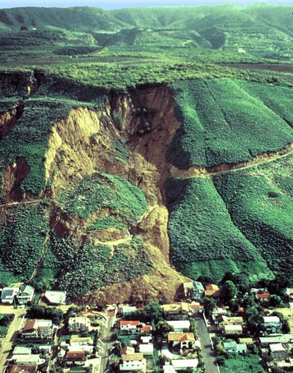
La Conchita Landslide
Aerial view of the La Conchita Landslide in California. This landslide formed on the hillslopes above the community built on a narrow coastal plain along the Pacific Ocean between Santa Barbara and Ventura. The landslide formed in soft (poorly consolidated) sediments on the western slope of Rincon Mountain. On January 10, 2005, an earthflow (landslide) at La Conchita destroyed or seriously damaged 36 homes and killed 10 people.
http://3dparks.wr.usgs.gov/landslide/landslides.htm
Notes:
Aerial view of the La Conchita Landslide in California. This landslide formed on the hillslopes above the community built on a narrow coastal plain along the Pacific Ocean between Santa Barbara and Ventura. The landslide formed in soft (poorly consolidated) sediments on the western slope of Rincon Mountain. On January 10, 2005, an earthflow (landslide) at La Conchita destroyed or seriously damaged 36 homes and killed 10 people. Another landslide occurred in the same vicinity in 1995 (without catastrophic results) and the hillslopes in the area display abundant evidence of landslide activity in the prehistoric past. The disaster at La Conchita illustrates the problems of development activities in landslide-prone areas. For more information see Landslide Hazards at La Conchita by R.W. Jibson [http://pubs.usgs.gov/of/2005/1067/]. (Photograph by R.L. Schuster, U.S. Geological Survey, 1995.)

Slide 10
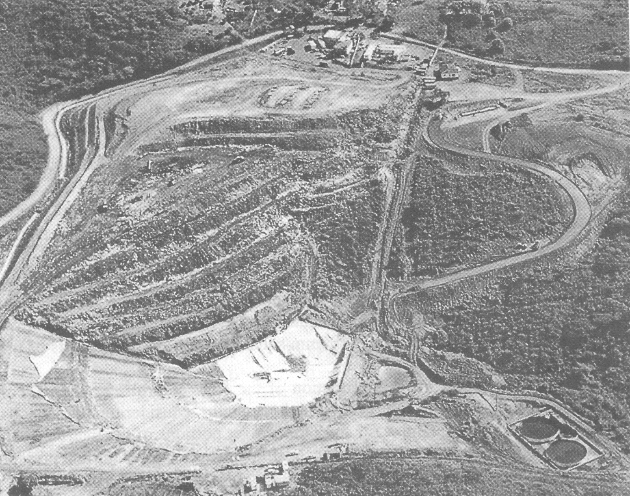
Landfill Slope Failure - Before
Notes:
Canyon type landfill. New cell at toe of existing fill.
Brink et al. 1999

Slide 11
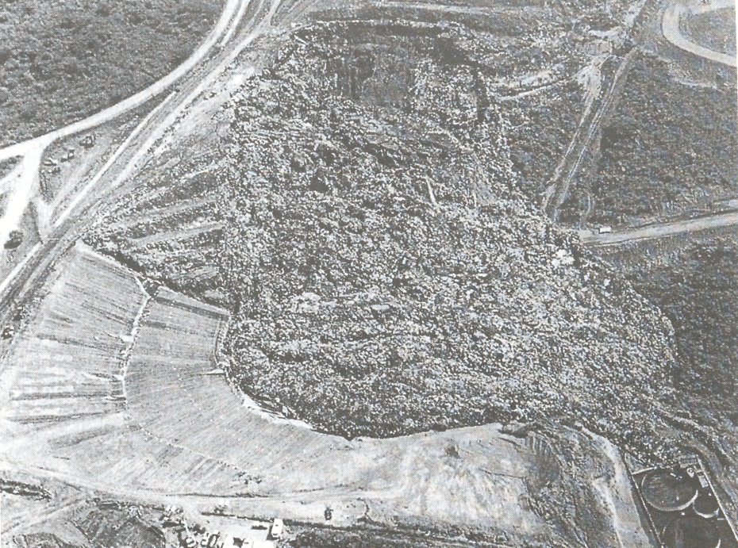
Landfill Slope Failure - After

Slide 12
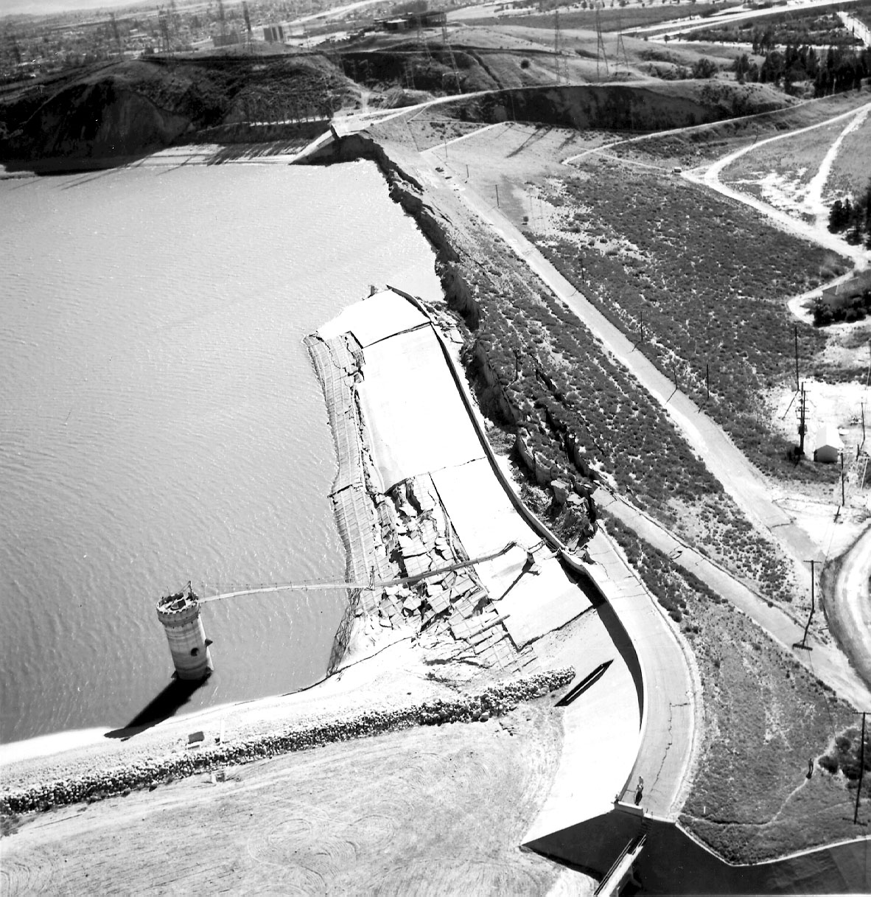
Loma Prieta Earthquake, 1972
Notes:
Lower Van Norman Dam
18” freeboard
100,000+ living directly below dam

Slide 13
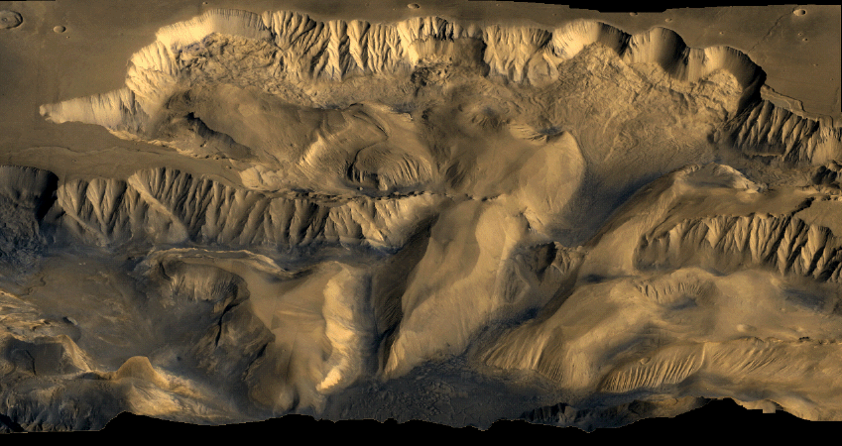
Slope Failures on Mars

Slide 14
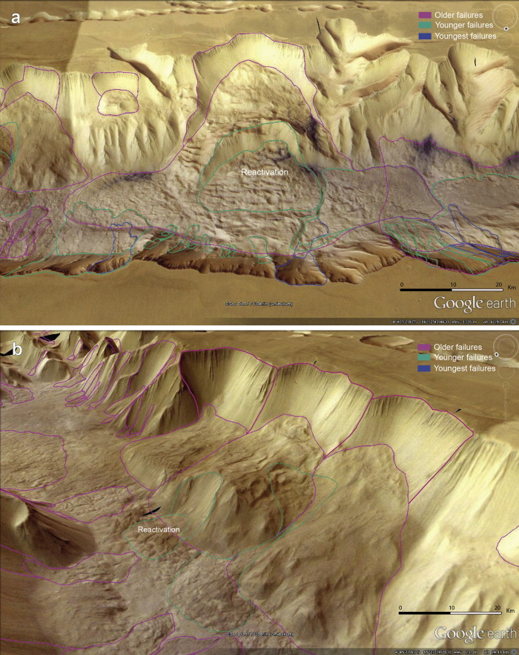

Slide 15
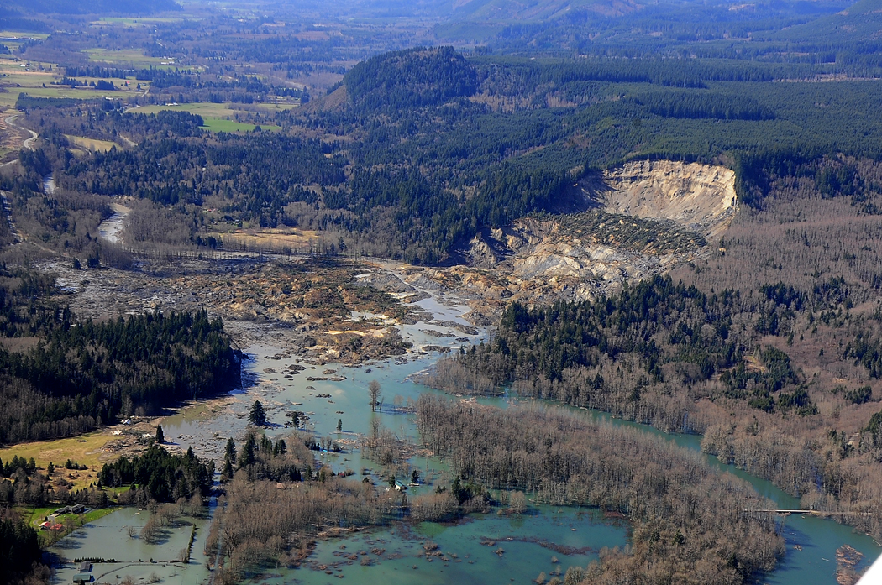
Oso, Washington Landslide
3/22/2014
10M yd^3 of soil
30 homes destroyed
43 fatalities
Moved 0.7 miles at 40 mph

Slide 16
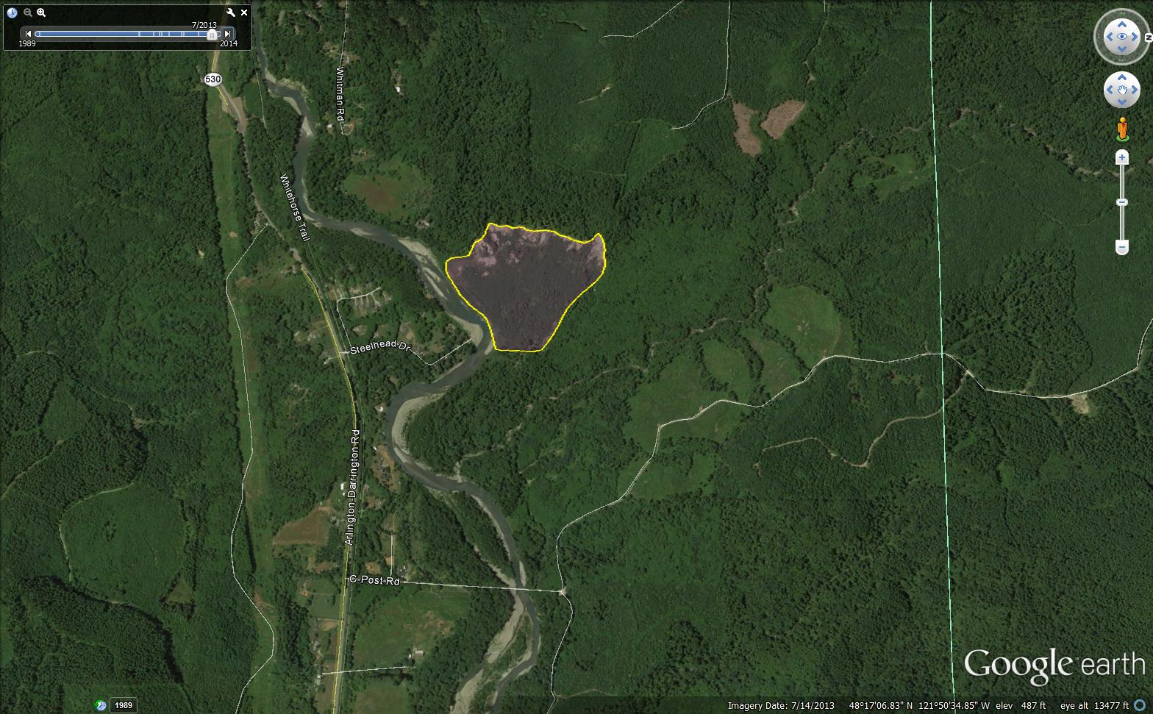
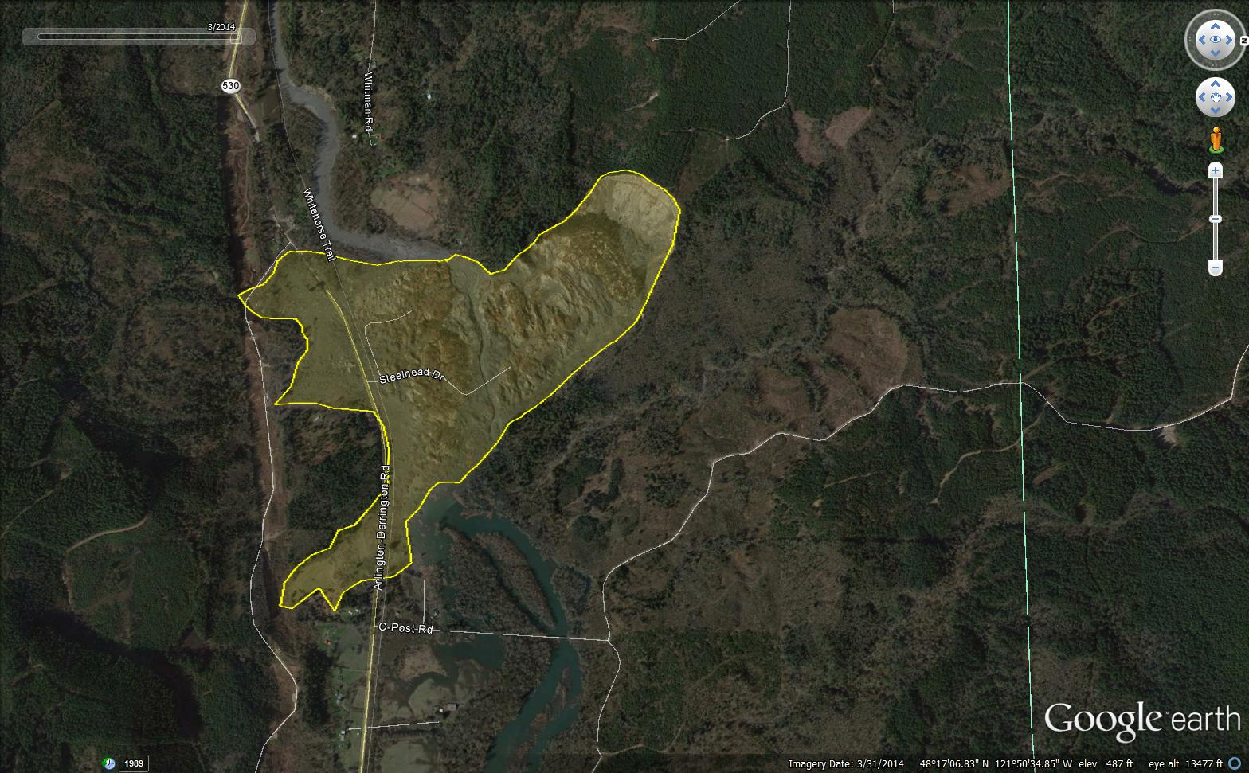
Before (07/2013)|After (03/2014)

Slide 17
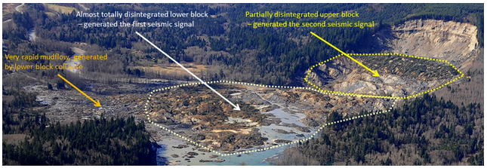
Sequence of Events
Notes:
The landslide occurred in two stages. First, a lower segment of the slope gave way. Followed by progressive failures of the upper slope. As the upper block gave way it produced large compressional forces causing an undrained loading condition for the lower block and subsequently cause static liquefaction. This led to the rapid mobility of mudflows at the base of the landslide.

Slide 18
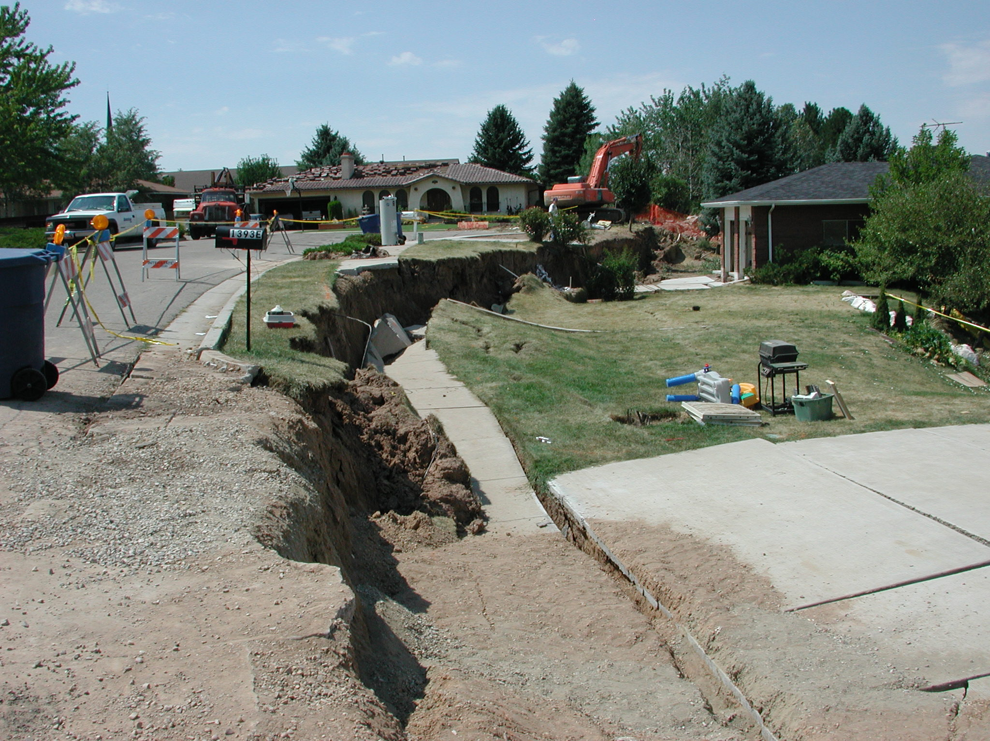
Utah, 2001

Slide 19
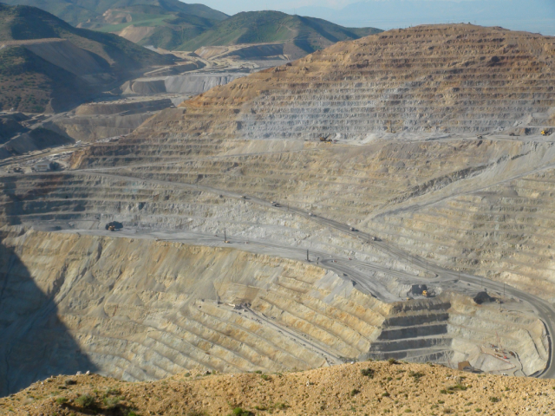
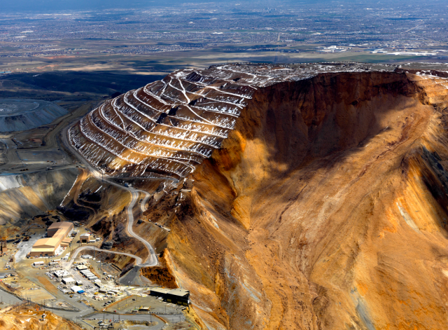
Bingham Canyon Mine (2015)
Before
After
“On April 10, 2013 an enormous landslide dumped 165 million tons of dirt into the bottom of the Bingham Canyon Mine. That amount of dirt could fill 19,000 miles of railcars and stretch three-quarters of the way around the world.
The slide was even recorded at the University of Utah’s seismograph station, measuring at a magnitude of 2.4.”
http://www.utahbusiness.com/articles/view/hole_in_the_ground#sthash.VDgeqA7G.dpuf

Slide 20
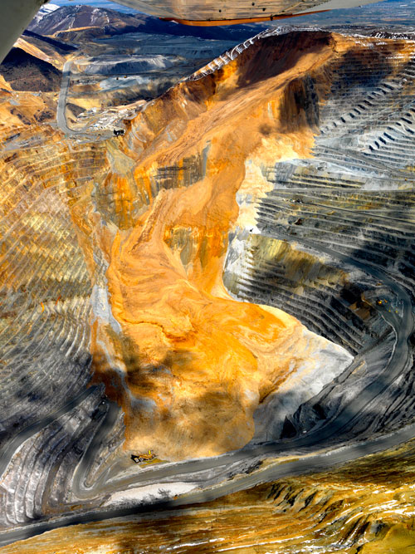
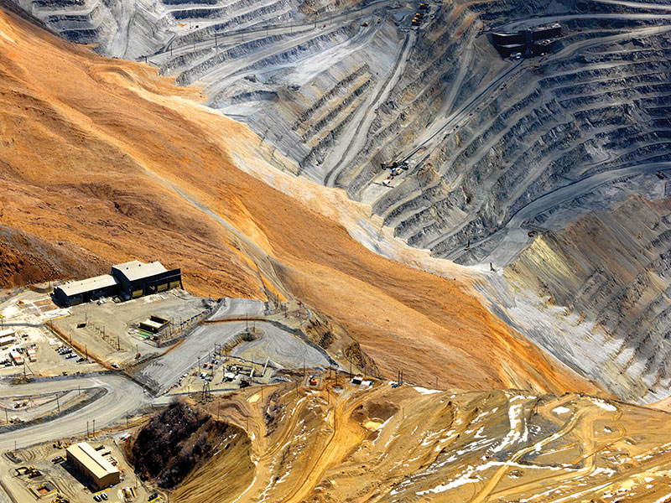
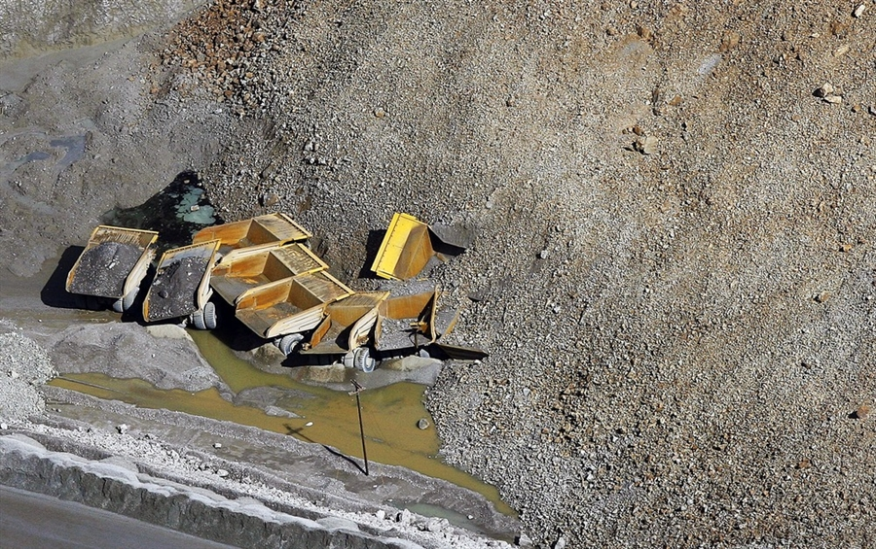

Slide 21
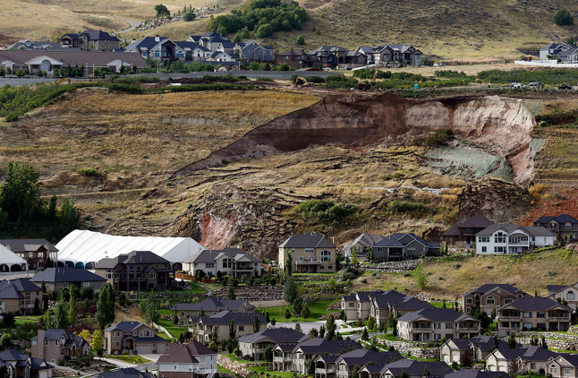
North Salt Lake (2014)
The landslide involved an engineered slope that had been part of a gravel pit in the 1990s, but has since been reclaimed and partially developed into the Eaglepointe subdivision.

Slide 22
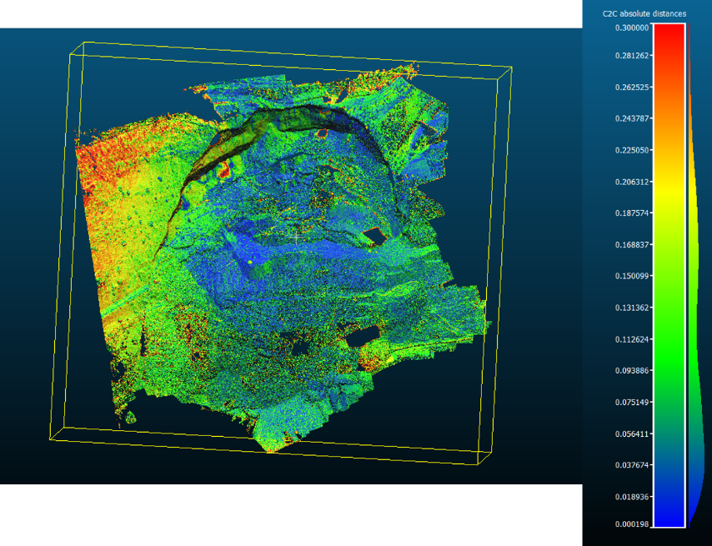
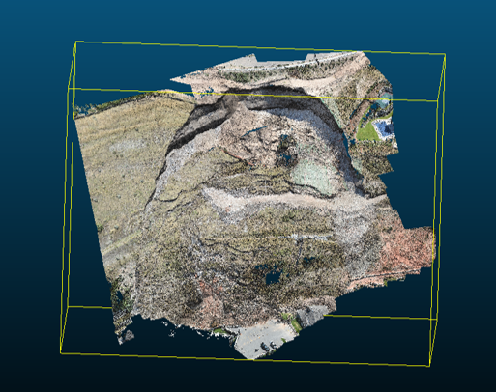
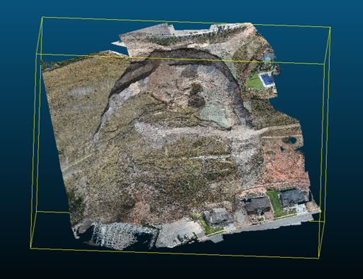
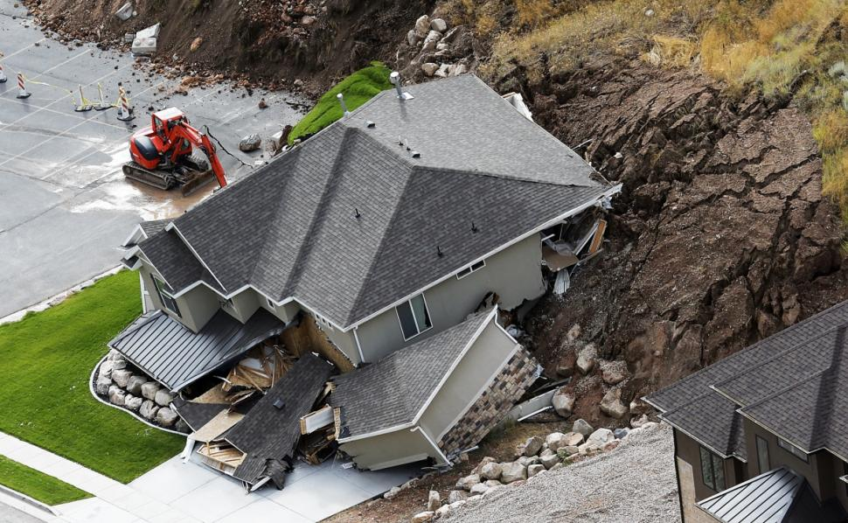
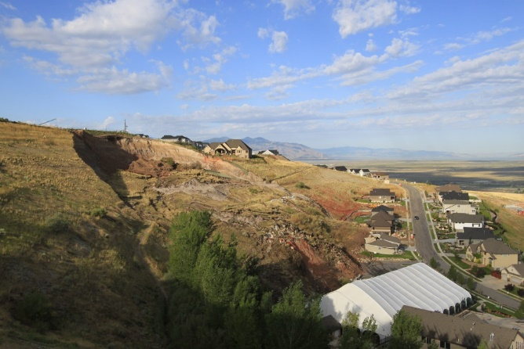
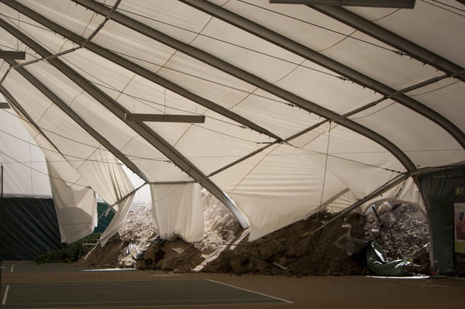
Damage
Notes:
Preliminary estimates suggest a landslide volume of 300,000 to 400,000 cubic yards, based on an assumed depth of between 30 and 50 feet. The pre-slide slope had a local relief (change in elevation) of about 200 feet
Only one house was directly damaged. The home was pushed off its foundation and destroyed.
A tennis court was also damaged.
A backyard and part of a hiking trail were carried away by the landslide.
Immediately after the landslide, 27 homes were evacuated.
No one was injured during the landslide.

Slide 23
Shallow Slides/Debris Flows
Examples

Slide 24
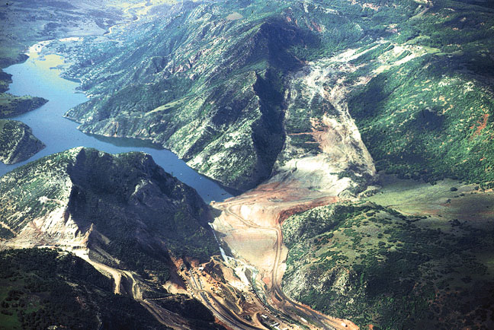
Thistle, Utah - 1983
Notes:
Thistle, Utah slide. 1983

Slide 25
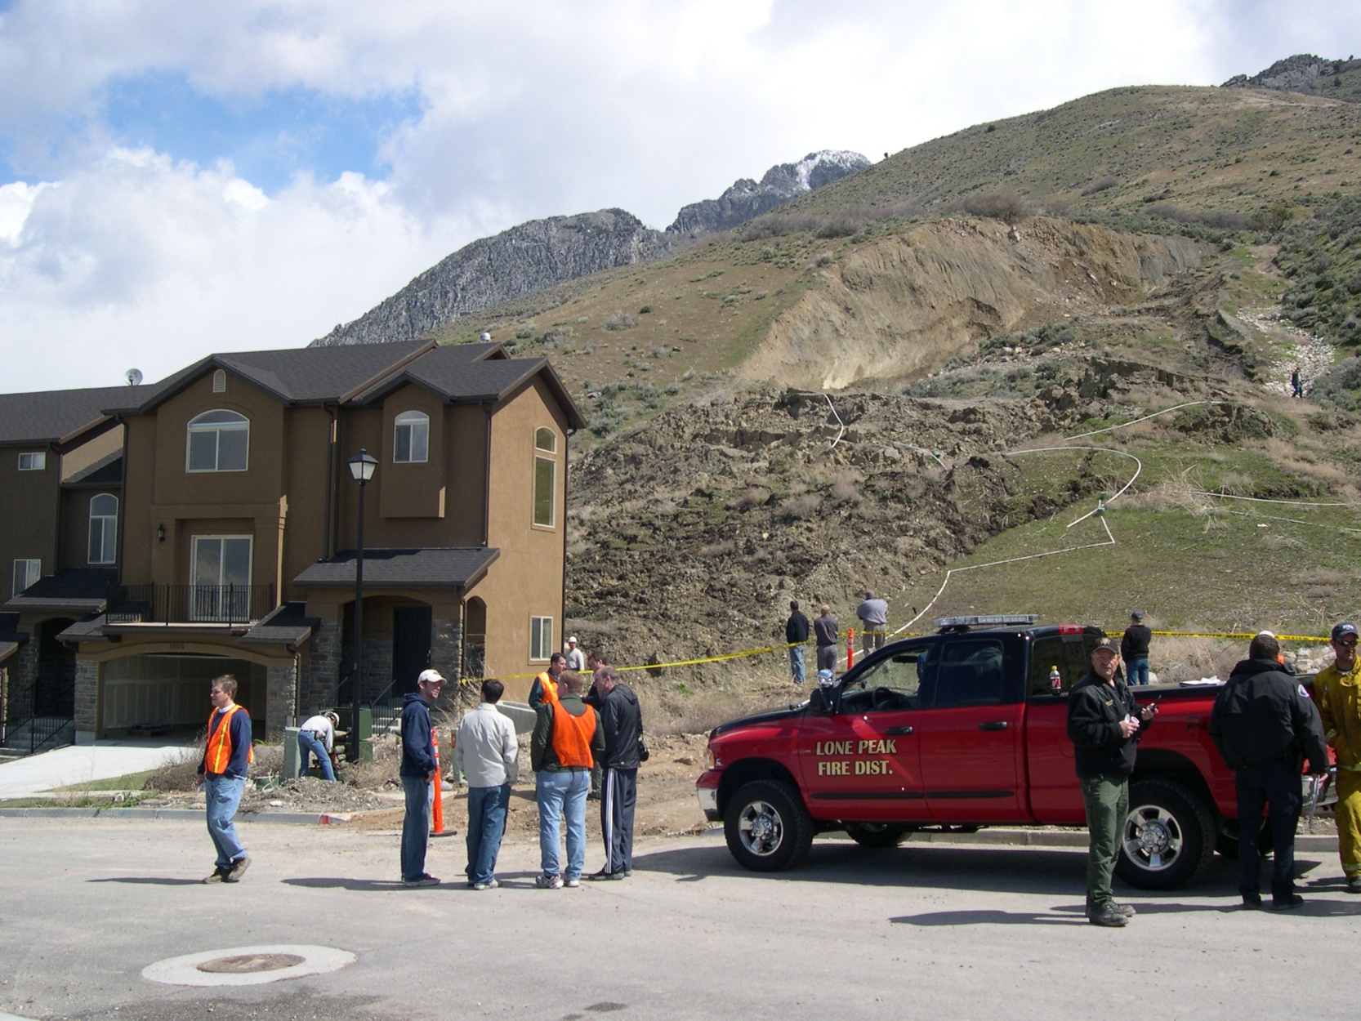
Utah, 2005

Slide 26
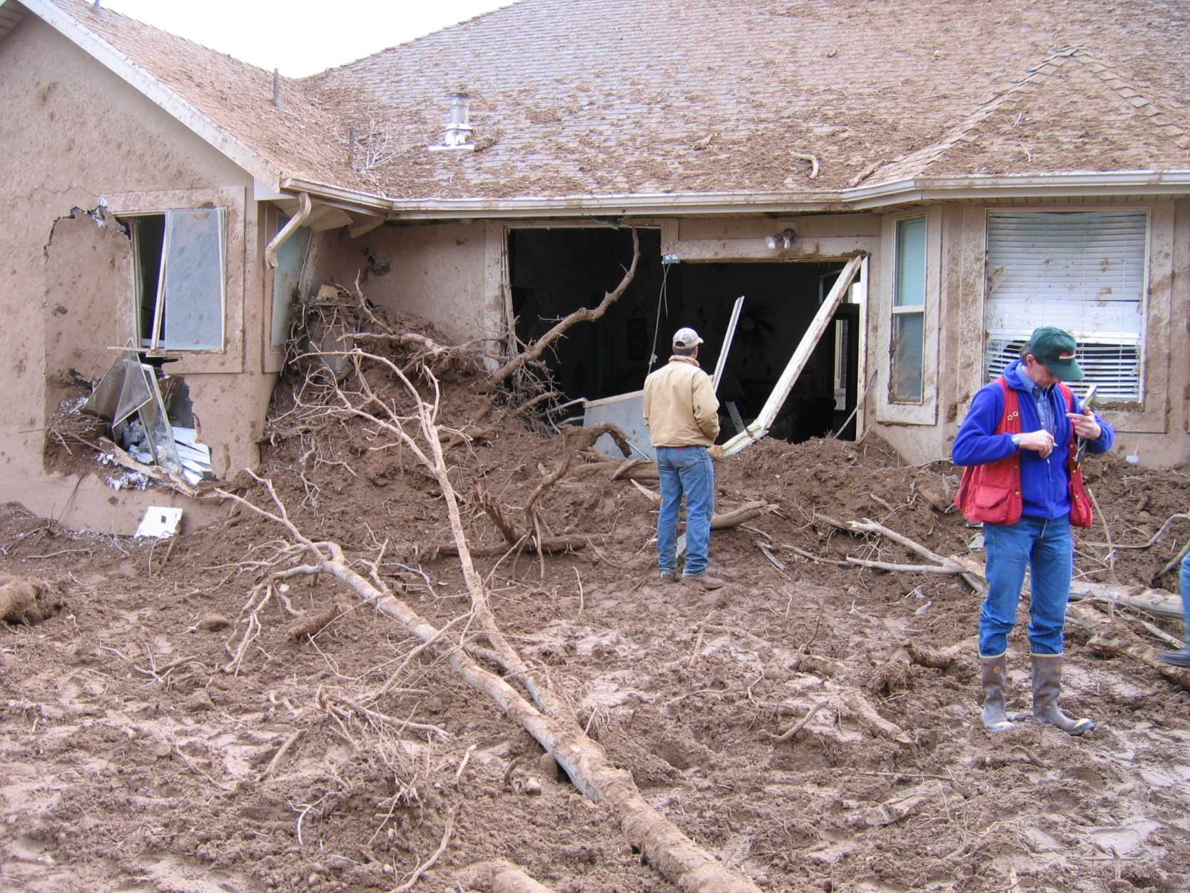
Utah, 2006

Slide 27
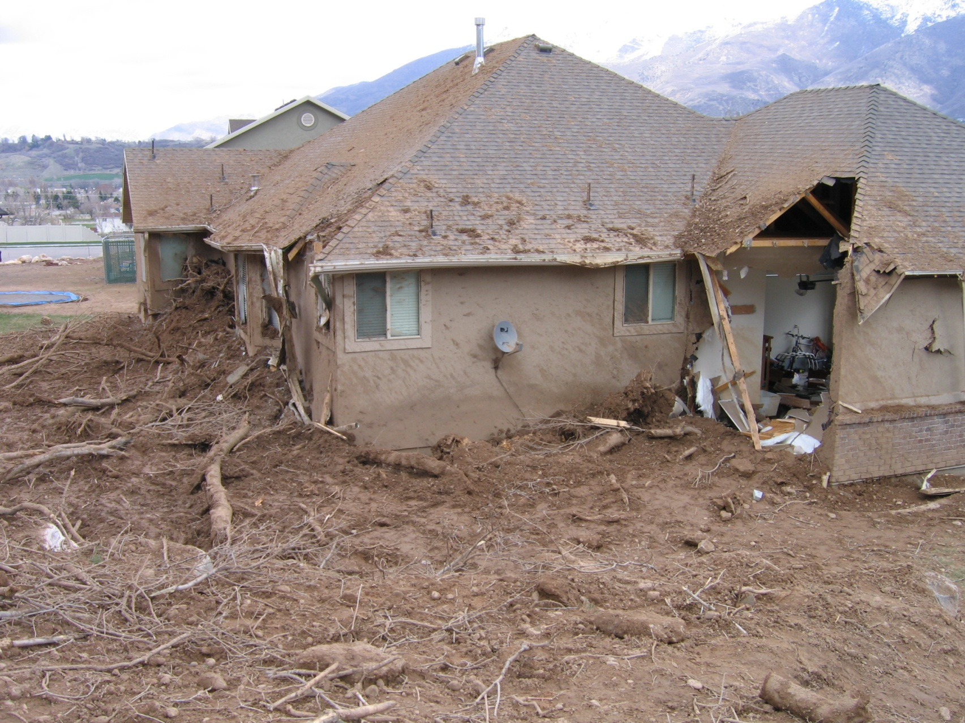
Utah, 2006

Slide 28
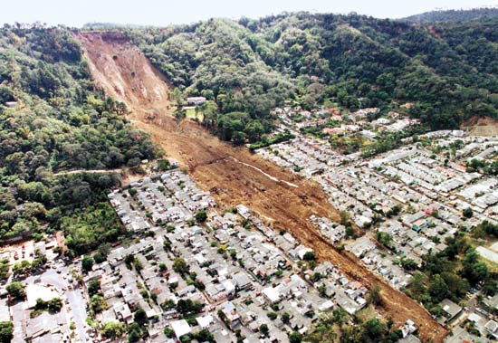
South America

Slide 29
Quick Clays
Clay particles deposited in a marine environment (high cation concentration) leading to a flocculated soil structure
Land rises over time above sea level. Fresh water leaches salts, leading to unstable dispersed structure
https://www.youtube.com/watch?v=LgDQsYAcS3o

Slide 30
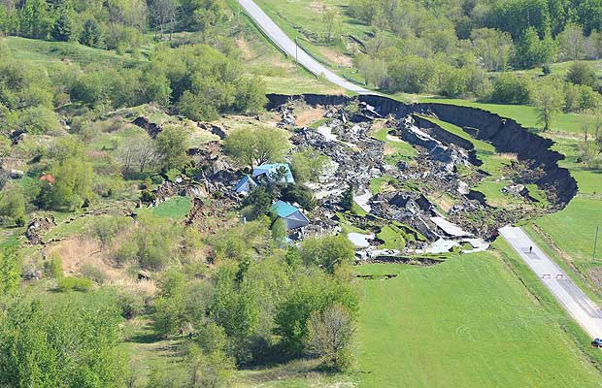
St Jude, Canada – 2010 (Leda Clay)
Quick clay slide

Slide 31
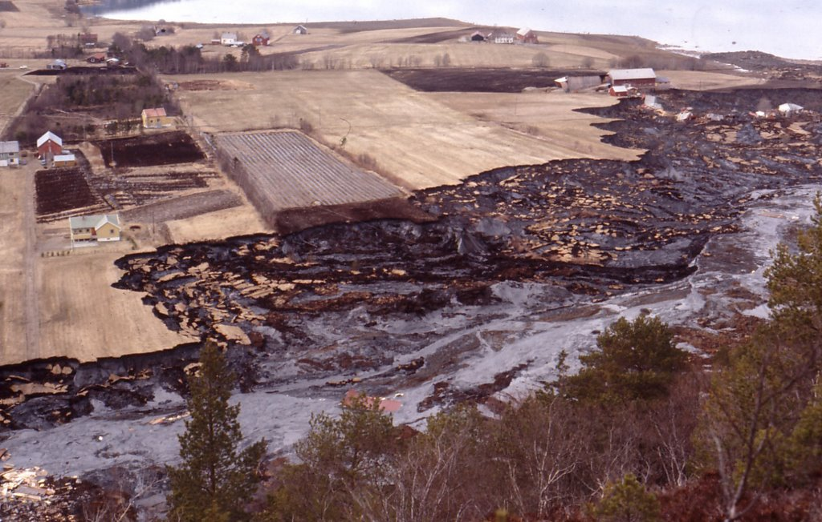
Rissa, Norway – 1978
Quick clay slide

Slide 32
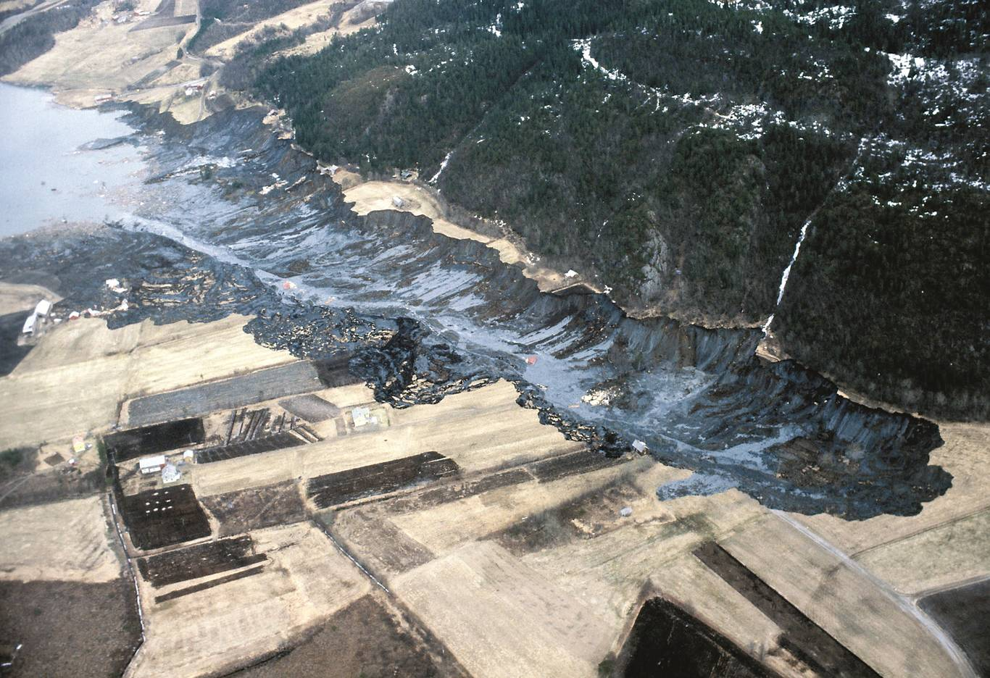
Rissa Norway, Cont
Quick clay slide

Slide 33
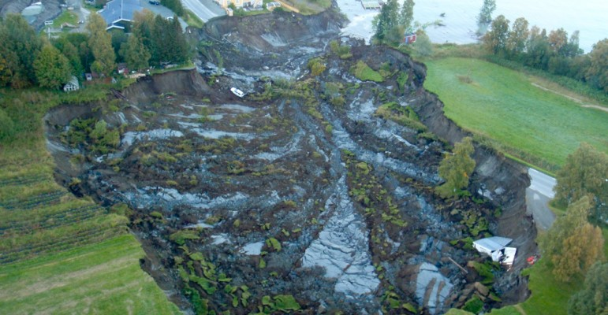
Norway 2010
Quick clay slide

Slide 34
Causes of Slope Failure

Slide 35
Causes of Slope Failure
It is important to understand the changes in the properties of the soils that may occur over time and the various loading and seepage conditions to which the slope will be subjected.
It is important to understand the essential elements of the situation that led to the failure so that the repetition of the failure can be avoided.

Slide 36
Fundamental Stability Requirement
The strength of the soil must be greater than the shear stress required for equilibrium along the failure surface
Stress may exceed strength as a result of:
A decrease in the shear strength of the soil
An increase in the shear stress required for equilibrium

Slide 37
Decrease in Shear Strength
Increased pore pressure (reduced effective stress)
Cracking
Swelling (increase in void ratio)
Development of slickensides
Decomposition of clayey rock fills
Creep under sustained loads
Leaching (quick clays)
Strain softening (peak vs residual strength)
Weathering
Cyclic loading

Slide 38
Increase in Shear Stress
Loads at the top of the slope
Water pressure in cracks at the top of the slope.
Increase in soil weight due to increased water content
Excavation at the bottom of the slope.
Drop in water level at the base of a slope.
Earthquake shaking

Slide 39
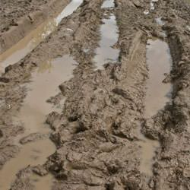
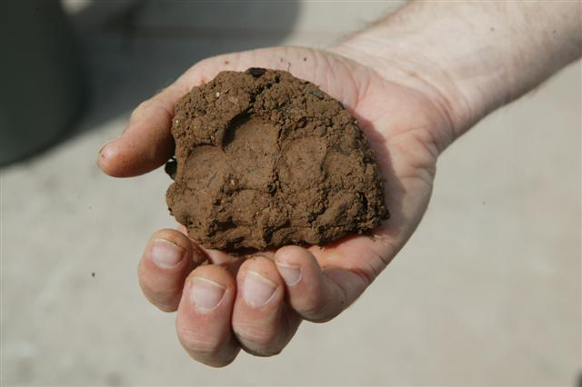
Water
Most of these causes (and by extension – most slope failures) involve water and clayey soils to some degree

Slide 40
Summary
Typically more than one cause
Difficult to untangle in some cases due to the complexity of the stresses and the soil mechanics
We will develop a systematic computational technique that can be used to analyze the causes of previous failures or estimate the probability/risk of future failures

